Slide 1

PHYS 498 SQD Fall 2019
Superconductivity and Superconductor Devices for Quantum Information Science
Dale J. Van Harlingen
Office: 1020 MRL (in the “Superconductivity Center” between MRL and ESB)
Email: dvh@Illinois.edu

Slide 2
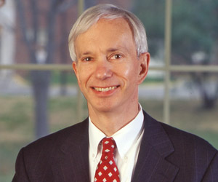
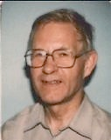
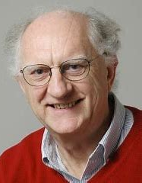
Dale J. Van Harlingen --- My Physics Research Career
Professor, Department of Physics (Head: 2006-2018)
Executive Associate Director, IQUIST = Illinois Quantum Information Science and Technology Center
University of Illinois at Urbana-Champaign
1978
1977
1981
2001-2
1968
OHIO STATE
CAMBRIDGE
UC BERKELEY
(Jim Garland)
(John Waldram)
(John Clarke)
UIUC
Dayton, Ohio
2018-19
Thesis: Thermoelectric Effects in Superconductors
Josephson effect
Non-equilibrium superconductivity
Microfabrication
Superconductor devices
SQUIDs
Experimental Condensed Matter Physics
Superconducting materials and devices, micro/nanofabrication,
Josephson physics, SQUIDs, scanning SQUID microscopy,
topological materials, Majorana fermions, quantum information science

Slide 3
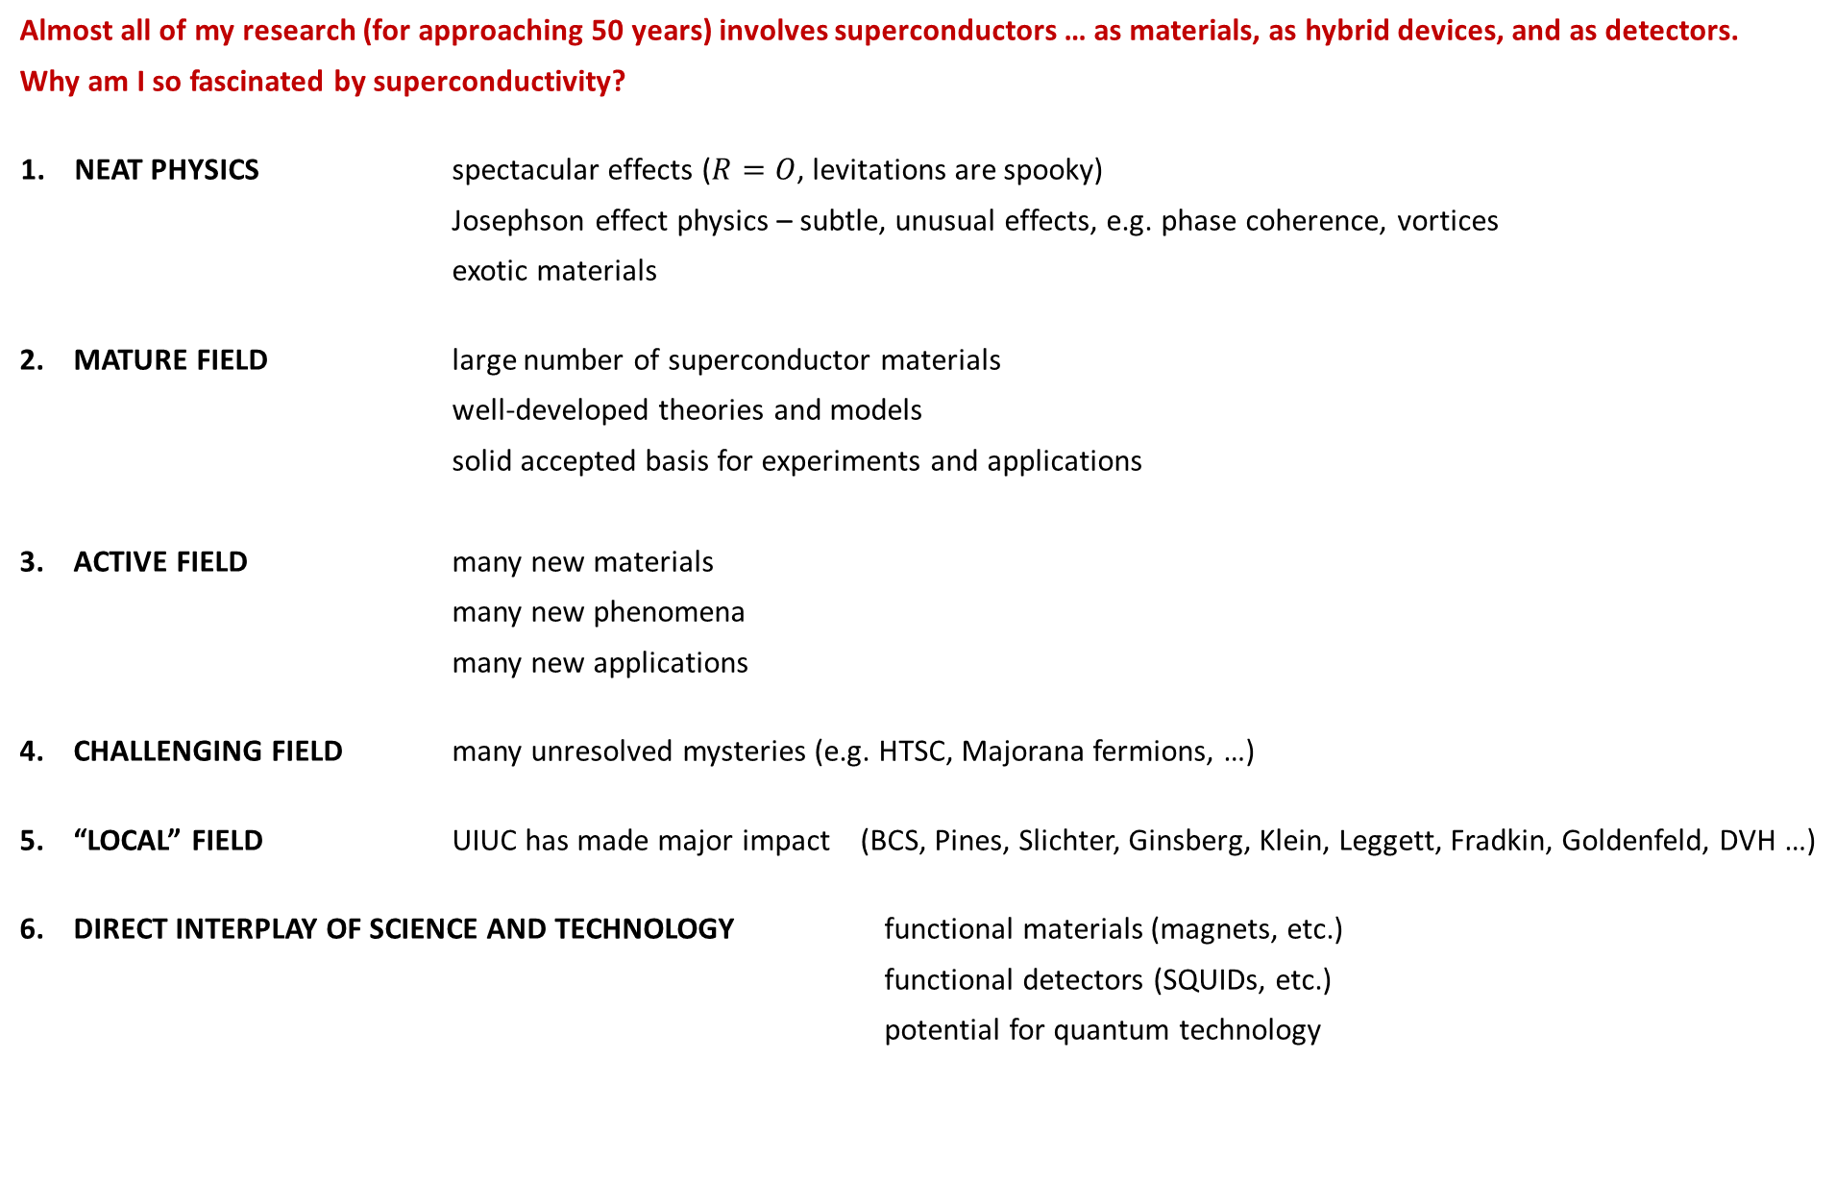
Almost all of my research (for approaching 50 years) involves superconductors … as materials, as hybrid devices, and as detectors.
Why am I so fascinated by superconductivity?
NEAT PHYSICS spectacular effects ($R=O$, levitations are spooky)
Josephson effect physics – subtle, unusual effects, e.g. phase coherence, vortices
exotic materials
2. MATURE FIELD large number of superconductor materials
            well-developed theories and models
            solid accepted basis for experiments and applications
ACTIVE FIELD many new materials
many new phenomena
many new applications
4. CHALLENGING FIELD many unresolved mysteries (e.g. HTSC, Majorana fermions, …)
5. “LOCAL” FIELD UIUC has made major impact (BCS, Pines, Slichter, Ginsberg, Klein, Leggett, Fradkin, Goldenfeld, DVH …)
DIRECT INTERPLAY OF SCIENCE AND TECHNOLOGY functional materials (magnets, etc.)
functional detectors (SQUIDs, etc.)
potential for quantum technology

Slide 4
7. VALUABLE TEST SYSTEMS FOR FUNDAMENTAL SCIENCE
Best understood many-body system (complex best transtable)
Examples chaos and non-linear effects
macroscopic quantum effects
phase transitions
low dimensional physics
mesoscopic physics
percolation
localization
phase coherence - vortices
fluctuations/noise
8. APPLICATIONS – SCIENTIFIC AND INDUSTRIAL
Quantum-levitation detectors and amplifiers– SQUIDs
High frequency radiation detection
Digital devices
Qubits
SCIENTIFIC IMPORTANCE – Mechanism of HTSC is the single biggest unsolved problem in Condensed Matter Physics
TECHNOLOGICAL IMPORTANCE – Quantum information science will lead to transformative technologies and superconductivity may well play a leading role!
Many NOBEL PRIZES in this field – I always hoped I could get one!

Slide 5
Nobel Prizes in Superconductivity
The Nobel Prize in Physics 1913
Heike Kamerlingh Onnes “for his investigations on the properties of matter at low temperatures which led, inter alia, to the production of liquid helium”
The Nobel Prize in Physics 1962
Lev Davidovich Landau “for his pioneering theories for condensed matter, especially liquid helium”
The Nobel Prize in Physics 1972
John Bardeen, Leon Neil Cooper and John Robert Schrieffer “for their jointly developed theory of superconductivity, usually called the BCS-theory”
The Nobel Prize in Physics 1973
Leo Esaki and Ivar Giaever “for their experimental discoveries regarding tunneling phenomena in semiconductors and superconductors, respectively”
Brian David Josephson “for his theoretical predictions of the properties of a supercurrent through a tunnel barrier, in particular those phenomena which are generally known as the Josephson effects”
The Nobel Prize in Physics 1987
J. Georg Bednorz and K. Alexander Müller“for their important break-through in the discovery of superconductivity in ceramic materials”
The Nobel Prize in Physics 1991
Pierre-Gilles de Gennes “for discovering that methods developed for studying order phenomena in simple systems can be generalized to more complex forms of matter, in particular to liquid crystals and polymers”
The Nobel Prize in Physics 2003
Alexei A. Abrikosov, Vitaly L. Ginzburg and Anthony J. Leggett “for pioneering contributions to the theory of superconductors and superfluids”
The Nobel Prize in Physics 20??
Your name here

Slide 6
PHYS 498 SQD Fall 2019
Superconductor Materials and Devices for Quantum Information Science
Objectives of this course:
1. Tell you about superconductivity – materials, phenomena, and theories
Mostly classic/conventional superconductors because:
(1) all superconductors can be discussed in terms of classic superconductor properties
(2) most applications use classic superconductors, especially qubit device
But we will also talk a little about unconventional superconductors because:
(1) they are an exciting development in the field and many mysteries still remain
(2) superconductor devices play a key role in understanding some of their exotic properties
2. Tell you about superconductor device physics – based on tunneling and the Josephson effect
3. Tell you about the important role that superconductors play in quantum information science for quantum sensing and quantum computation as (probably) the leading technology for qubits
4. Tell you (a little) about the emerging field of topological superconductors and topologically-protected quantum computing based on Majorana fermion states (because many people at UIUC do this, like me )

Slide 7
PHYS 498 SQD Fall 2019
Superconductor Materials and Devices for Quantum Information Science
Relevance to Quantum Information Science:
There is probably no area hotter in science than quantum information
Recent discoveries and progress have made people worldwide aware of the potential of quantum mechanics for advanced detectors and quantum computing
There are significant investments by countries, industries, and universities (including ours) in this area:
UIUC has launched IQUIST = Illinois Quantum Information Science and Technology Center, and created CQE = Chicago Quantum Exchange, a consortium of partners in and near Chicago,
to promote activity in QIS, including encouraging training of students in QIS via courses like this

Slide 8

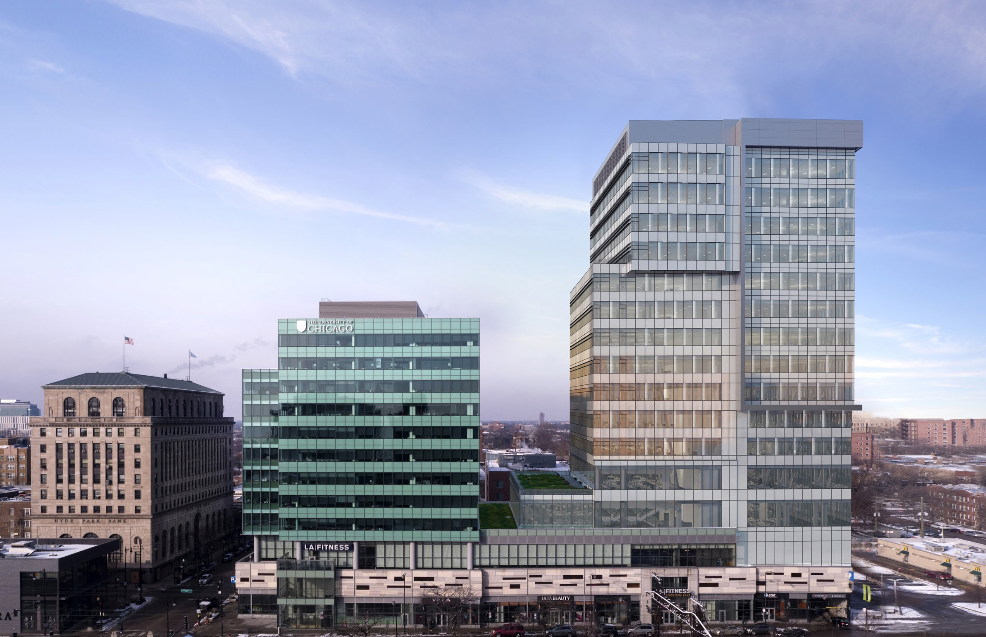



IQUIST
Illinois Quantum Information Science and Technology Center
Illinois Quantum Information Science and Technology Center
Interdisciplinary center to promote QIS research and education at UIUC
$15M Investment over 5 years by the campus and College of Engineering for:
  faculty hiring (8-10 positions in Physics, ECE, CS, etc.)
  infrastructure development --- space remodeling and research facitlities
  technical staff for film growth, device fabrication, measurement engineering
  educational programs
Leverages UIUC traditional strengths in condensed matter physics, electrical engineering, materials science, and computer science
The centerpiece is a heterogeneous quantum processor testbed based on networking multiple-qubit platforms = ion traps, superconducting qubits, etc.
IQUIST is the point-of-contact for interactions with other institutions, funding agencies, foundations, and industry
IQUIST will participate in collaborations and proposals with the Chicago Quantum Exchange (CQE) and all of its academic, national lab, and industrial partners
IQUIST will engage with the Polsky Center (Hyde Park) and Discovery Partners Institute (Chicago) to increase the impact of our research and educational programs, create opportunities for students, and build interactions with industry
Participants: 25 members and 15 affiliates from 6 academic departments
Director: Paul Kwiat
Associate Directors: Brian DeMarco and Dale Van Harlingen
Polsky/Wexford Center
Discovery Partners Institute
Chicago Quantum Exchange

Slide 9
IQUIST participants
IQUIST Leaders
Scientific Advisory Committee
Paul Kwiat --- Director
Dale Van Harlingen --- Executive Associate Director
Brian DeMarco --- Associate Director for Educational Programs
TBD --- Managing Director
Roy Campbell Paul Kwiat
Eric Chitambar Virginia Lorenz
Bryan Clark Vidya Madhavan
Brian DeMarco Dale Van Harlingen
Members (28) --- active in QIS
Physics (20)
Paul Kwiat
Tony Leggett
Virginia Lorenz
Vidya Madhavan
Fahad Mahmood
Nadya Mason
Dale Van Harlingen
Smitha Vishveshwara
CS (2)
Roy Campbell
Edgar Solomonik
MechSE (1)
Gaurav Bahl
Math (1)
Marius Junge
Philosophy (1)
Kohei Kishida
Alexey Bezryadin
David Ceperley
Barry Bradlyn
Bryan Clark
Brian DeMarco
Jim Eckstein
Aida El-Khadra
Tom Faulkner
Eduardo Fradkin
Bryce Gadway
Taylor Hughes
Yoni Kahn
Affiliates (14) --- interested in QIS
Physics (5):
Doug Beck
Patrick Draper
Philip Phillips
Mike Stone
Lucas Wagner
ECE (4):
Kent Choquette
John-Pierre Leburton
Olgica Milenkovic
Maxim Raginsky
ECE (3)
Eric Chitambar
Matthew Gilbert
Kejie Fang
MatSE (3):
David Cahill
Axel Hoffman
Dan Shoemaker
CS (2):
Gul Agha
Michael Forbes
IQUIST
Illinois Quantum Information Science and Technology Center

Slide 10






CQE member institutions
CQE industrial partners (so far)

Slide 11
PHYS 498 SQD Fall 2019
Superconductor Materials and Devices for Quantum Information Science
Relevance to Quantum Information Science:
There is probably no area hotter in science than quantum information
Recent discoveries and progress have made people worldwide aware of the potential of quantum mechanics for advanced detectors and quantum computing
There are significant investments by countries, industries, and universities (including ours) in this area:
UIUC has launched IQUIST = Illinois Quantum Information Science and Technology Center, and created CQE = Chicago Quantum Exchange, a consortium of partners in and near Chicago,
to promote activity in QIS, including encouraging training of students in QIS via courses like this
So, this NOT a course on QIS and I actually do NOT consider myself to be an expert in this emerging field
But superconductivity is one of the leading and most promising hardware approaches for achieving the goals of this effort and it is to likely play a major role in qubit devices and quantum circuits,
so I want to learn with you about what is happening and how to advance it
Throughout the course we will keep an eye on new developments and opportunities for superconductivity

Slide 12
Lecture | Date |  | Day | Topic
Superconductor materials and phenomena
0 | Aug | 27 | Tues | History and occurrence of superconductivity
1 | Aug | 29 | Thurs | Defining phenomena: zero resistance, diamagnetism, energy gap, …
2 | Sep | 3 | Tues | Phenomenological theories: two-fluid, London, thermodynamic, ...
3 | Sep | 5 | Thurs | Ginzburg-Landau theory
4 | Sep | 10 | Tues | Characteristic lengths and fields
5 | Sep | 12 | Thurs | Macroscopic phase coherence
6 | Sep | 17 | Tues | Vortex structure and dynamics
7 | Sep | 19 | Thurs | Microscopic theory --- BCS
8 | Sep | 24 | Tues | Nature of the ground state
9 | Sep | 26 | Thurs | Quasiparticle excitations and dynamics
10 | Oct | 1 | Tues | Non-equilibrium effects, transport properties, and fluctuations
11 | Oct | 3 | Thurs | Beyond BCS --- unconventional superconductivity, …
Quasiparticle and Josephson tunneling
12 | Oct | 8 | Tues | Quasiparticle tunneling - theory
13 | Oct | 10 | Thurs | Quasiparticle tunneling - applications
14 | Oct | 15 | Tues | Josephson tunneling - theory
15 | Oct | 17 | Thurs | Josephson tunneling – dc/ac effects
16 | Oct | 22 | Tues | Josephson tunneling – magnetic field effects and Josephson interferometry
 | Oct | 23 | Wed | Superconducting phenomenon/material paper due
17 | Oct | 24 | Thurs | Phase dynamics – the RSJ model
18 | Oct | 29 | Tues | Phase perturbations – thermal, quantum, rf, optical, ...
19 | Oct | 31 | Thurs | Microbridges/SNS Junctions/SFS junctions
20 | Nov | 5 | Tues | Phase coherence/quantum interference/SQUIDs
21 | Nov | 7 | Thurs | Mesoscopic superconductors: charging effects, nanowires, SETs, …
Superconductor devices for Quantum Information
22 | Nov | 12 | Tues | Quantum computing --- advantages and algorithms
23 | Nov | 14 | Thurs | Macroscopic quantum tunneling and coherence
24 | Nov | 19 | Tues | Conventional superconducting qubits
25 | Nov | 21 | Thurs | Superconducting qubit technology
 | Nov | 26 | Tues | Thanksgiving Break
 | Nov | 28 | Thurs | Thanksgiving Break
26 | Dec | 3 | Tues | Topological materials and Majorana fermions
28 | Dec | 5 | Thurs | Majorana qubits --- nanowires
29 | Dec | 10 | Tues | Majorana qubits --- S-TI-S junctiosn
 | Dec | 12 | Thurs | READING DAY
 | Dec | ? | Wed | FINAL EXAM --- Superconductor device paper due
Course content:
Superconductor materials and phenomena
Superconductor device physics
Paper #1
Applications in quantum information
Paper #2

Slide 13
Course materials
RECOMMENDED TEXTBOOKS:
Superconductivity. For the coverage of basic superconductivity, I will rely most heavily on Introduction to Superconductivity (Second Edition) by Michael Tinkham. It is a classic text and covers most completely the topics in the course concerning basic superconductivity. I also like Superconductivity of Metals and Cuprates by John Waldram –very readable and insightful
Superconductor Devices. For the coverage of superconductor devices, I will rely on most on Introduction to Superconducting Devices by Kadin, Physics and Applications of the Josephson Effects, by Barone and Paterno, and Principles of Superconductive Devices and Circuits by Van Duzer and Turner.
Other favorite references (and some biased comments about them):
SUPERCONDUCTIVITY
Blatt, J. M. Theory of Superconductivity Early theoretical treatment. Perhaps more interesting than useful.
Academic Press, 1964.
DeGennes, P. G. Superconductivity in Metals and Alloys A classic. Still the best treatment of Ginzburg-Landau theory and its application to proximity effects
Addison-Wesley, 1989. and interfaces.
Ginsberg, D. M. Physical Properties of High Temperature A comprehensive compilation of experimental data of the high-Tc superconductors.
Superconductors, I-V
Lynton, E. A. Superconductivity Summary of early phenomena. Pretty dated now.
Metheun & Co., 1969.
Parks, R. D. Superconductivity, Volumes I and II Comprehensive review of the field at the time. Still has information that does not appear elsewhere.
Marcel Dekker, 1969.
Rose-Innes, A. C. Introduction to Superconductivity Very phenomenological. A pretty good elementary treatment.
Rhoderick, F. H. Pergamon Press, 1969.
Schrieffer, J. R. Theory of Superconductivity Very theoretical, but some interesting early perspectives. Mostly BCS, of course.
W. A. Benjamin, 1964.
Tinkham, M. Introduction to Superconductivity (2nd edition) Best overall text for basic superconductivity (covering all the things that his research group worked on!).
Waldram, J. R. Superconductivity of Metals and Cuprates Excellent book that presents the key concepts in a clear and readable way. I have always been impressed Institute of Physics Publishing, 1996. with Waldram’s knowledge and writing (I worked for him as a postdoc at Cambridge).

Slide 14
Useful chapters in standard Solid State textbooks:
Ashcroft and Mermin Solid State Physics (Chapter 34)
Kittel Introduction to the Theory of Solids (Chapter 12)
Ziman Principles of the Theory of Solids (Chapter 11)
SUPERCONDUCTOR DEVICES
Anderson, P. W. "The Josephson Effect and Quantum Coherence Measurements In Superconductors and Superfluids"
Progress in Low Temperature Physics, Vol. V, 1967.
Some good insights into the Josephson effect.
Barone, A. Physics and Applications of the Josephson Effect
Paterno, G. Wiley & Sons, 1982.
By far, the most detailed treatment of Josephson physics.
Kadin, A. M Introduction to Superconducting Circuits
Wiley & Sons, 1999.
A book that describes superconductor devices from a circuit model approach, developing a framework for designing and characterizing superconductor electronics. offer valuable insights and information.
Likharev, K. K. Dynamics of Josephson Junctions and Circuits
Gordon and Breach, 1986.
Theoretical, advanced treatment with device examples.
Lounasmaa, O. V. Experimental Principles and Methods below 1K
Academic Press , 1974.
An old low temperature experimental techniques book with a good description of rf SQUID operation and applications for thermometry and magnetometry.
Orlando, T. P. Foundations of Applied Superconductivity
Delin, K. A. Addison-Wesley, 1991.
Heavy emphasis on engineering aspects but also some good explanations of basic science and very thorough reference guides.
Ruggiero, S. T. Superconducting Devices
Rudman, D. A. Academic Press, 1990.
Book of articles covering device applications of superconductors with emphasis on the potential of the high temperature superconductors.
Schwartz, B. Superconductor Applications: SQUIDs and Machines
Foner, S. Plenum, 1977.
Overview of superconductor technology at the time. Dated now, but some articles, especially John Clarke's description of SQUIDs, are still pretty useful.
Solymar, L. Superconductive Tunneling and Applications
Wiley-Interscience, 1972.
A good introduction to tunneling, both quasiparticle and Josephson.
Van Duzer, T. Principles of Superconductive Devices and Circuits
Turner, C. W Elsevier-North Holland, 1981.
A reference text that touches on most of the topics we will cover in this course. Sketchy in places but overall pretty good.
Waldram, J. R. "The Josephson effects in weakly-coupled Superconductors"
Rep. Prog. Phys 39, 751 (1976).
Highly-recommended review. A well-written insightful treatise on the Josephson effect by a colleague of Brian Josephson at Cambridge. A personal favorite.
Course materials (cont’d.)
SUPERCONDUCTOR DEVICES
Anderson, P. W. "The Josephson Effect and Quantum Coherence An article with some good insights into the Josephson effect.
Measurements In Superconductors and Superfluids"
Progress in Low Temperature Physics, Vol. V, 1967.
Barone, A. Physics and Applications of the Josephson Effect By far, the most detailed treatment of Josephson physics.
Paterno, G. Wiley & Sons, 1982.
Kadin, A. M Introduction to Superconducting Circuits A book that describes superconductor devices from a circuit model approach, developing
Wiley & Sons, 1999. a framework for designing and characterizing superconductor electronics.
Likharev, K. K. Dynamics of Josephson Junctions and Circuits Theoretical, advanced treatment with device examples.
Gordon and Breach, 1986.
Lounasmaa, O. V. Experimental Principles and Methods below 1K An old low temperature experimental techniques book with a good description of rf Academic Press , 1974. SQUID operation and applications for thermometry and magnetometry.
Orlando, T. P. Foundations of Applied Superconductivity Heavy emphasis on engineering aspects but also some good explanations of basic
Delin, K. A. Addison-Wesley, 1991. science and very thorough reference guides.
Ruggiero, S. T. Superconducting Devices Book of articles covering device applications of superconductors with emphasis on the
Rudman, D. A. Academic Press, 1990. potential of the high temperature superconductors.
Schwartz, B. Superconductor Applications: SQUIDs and Machines Overview of superconductor technology at the time. Dated now, but some articles, Foner, S. Plenum, 1977. especially John Clarke's description of SQUIDs, are still pretty useful.
Solymar, L. Superconductive Tunneling and Applications A good introduction to tunneling, both quasiparticle and Josephson.
Wiley-Interscience, 1972.
Van Duzer, T. Principles of Superconductive Devices and Circuits A reference text that touches on most of the topics we will cover in this course. Sketchy
Turner, C. W Elsevier-North Holland, 1981. in places but overall pretty good.
Waldram, J. R. "Josephson effects in weakly-coupled Superconductors“ Highly-recommended review article. A well-written insightful treatise on the Josephson
Rep. Prog. Phys 39, 751 (1976). effect by a colleague of Brian Josephson at Cambridge. A personal favorite.

Slide 15
Course requirements
The grade in this course will be based on two papers to be prepared by each student:
1. The first will be due on October 23, approximately halfway through the course, and cover a topic of your choice on a superconductor material or phenomena.
2. The second will be due at the end of the course on December 10, and will cover a superconductor detector or measurement technique of your choice relevant to quantum materials, quantum sensors, or quantum computing.
Length ~ 10 pages
I will provide details and suggestions for topics later, but you should be on the lookout for topics that particularly interest you.
For graduate research students, the topic can be “relevant” to your thesis research project but should not be identical.
I may give an option to form two-person teams and write a longer paper.

Slide 16
Today
Lecture 1: History and Occurrence of Superconductivity
Useful to look at the history of superconductivity to see:
Evolution of the field --- how one discovery lead to others
Breadth and depth of field – can’t cover everything in this course
Set a baseline for analyzing new materials and devices
Next Tuesday
Lecture 2: Defining properties of superconductors

Slide 17
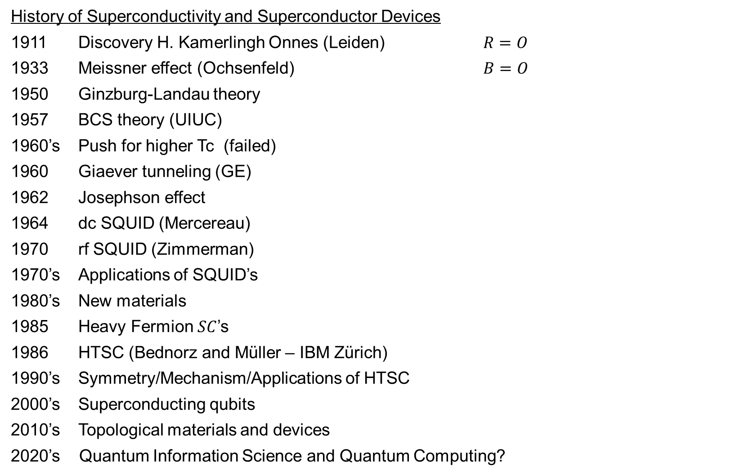
History of Superconductivity and Superconductor Devices
1911 Discovery H. Kamerlingh Onnes (Leiden) $R=O$
1933 Meissner effect (Ochsenfeld) $B=O$
1950 Ginzburg-Landau theory
1957 BCS theory (UIUC)
1960’s Push for higher Tc (failed)
1960 Giaever tunneling (GE)
1962 Josephson effect
1964 dc SQUID (Mercereau)
1970 rf SQUID (Zimmerman)
1970’s Applications of SQUID’s
1980’s New materials
1985 Heavy Fermion $SC$’s
1986 HTSC (Bednorz and Müller – IBM Zürich)
1990’s Symmetry/Mechanism/Applications of HTSC
2000’s Superconducting qubits
2010’s Topological materials and devices
2020’s Quantum Information Science and Quantum Computing?
ERA of discovery
“Superconductivity
is a solved problem”
ERA of devices
ERA of new materials and unconventional superconductivity
ERA of quantum information

Slide 18
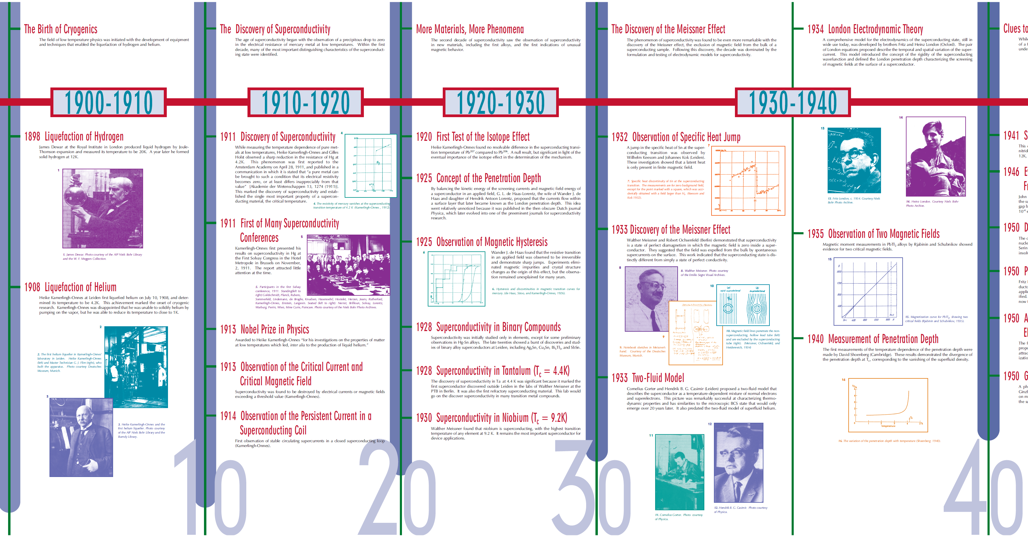
The HISTORY of SUPERCONDUCTIVITY and SUPERCONDUCTOR DEVICES (1911-1940)

Slide 19
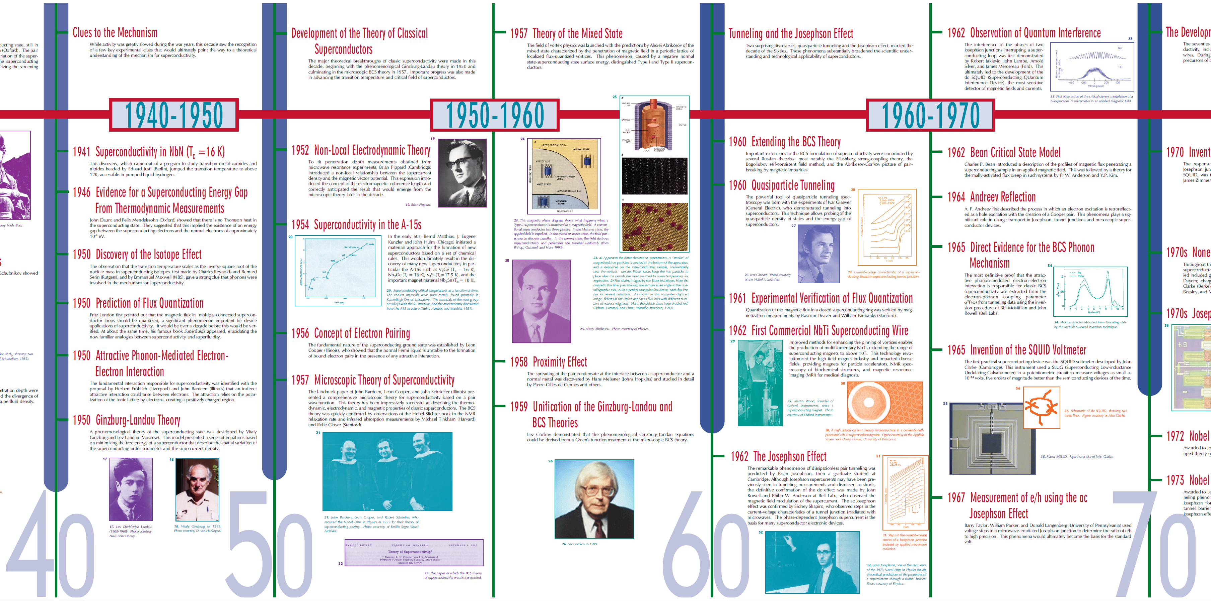
The HISTORY of SUPERCONDUCTIVITY and SUPERCONDUCTOR DEVICES (1940-1970)

Slide 20
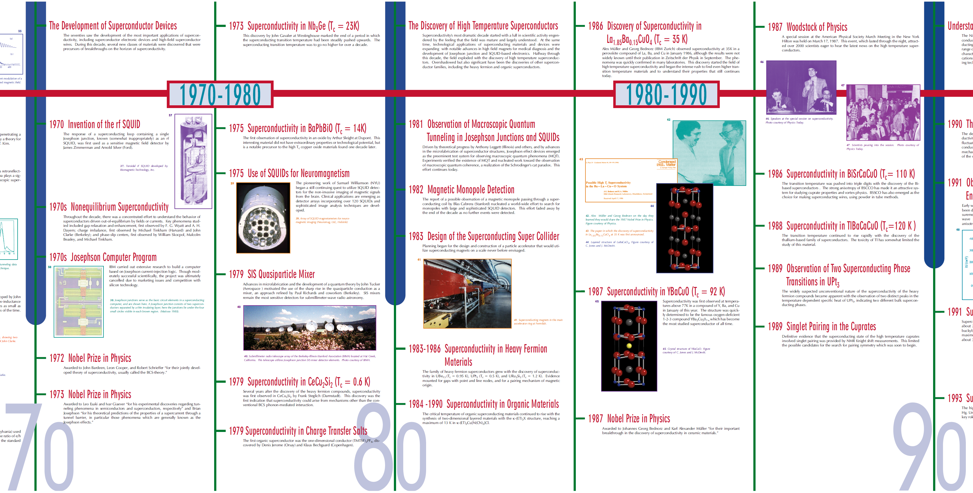
The HISTORY of SUPERCONDUCTIVITY and SUPERCONDUCTOR DEVICES (1940-1970)

Slide 21
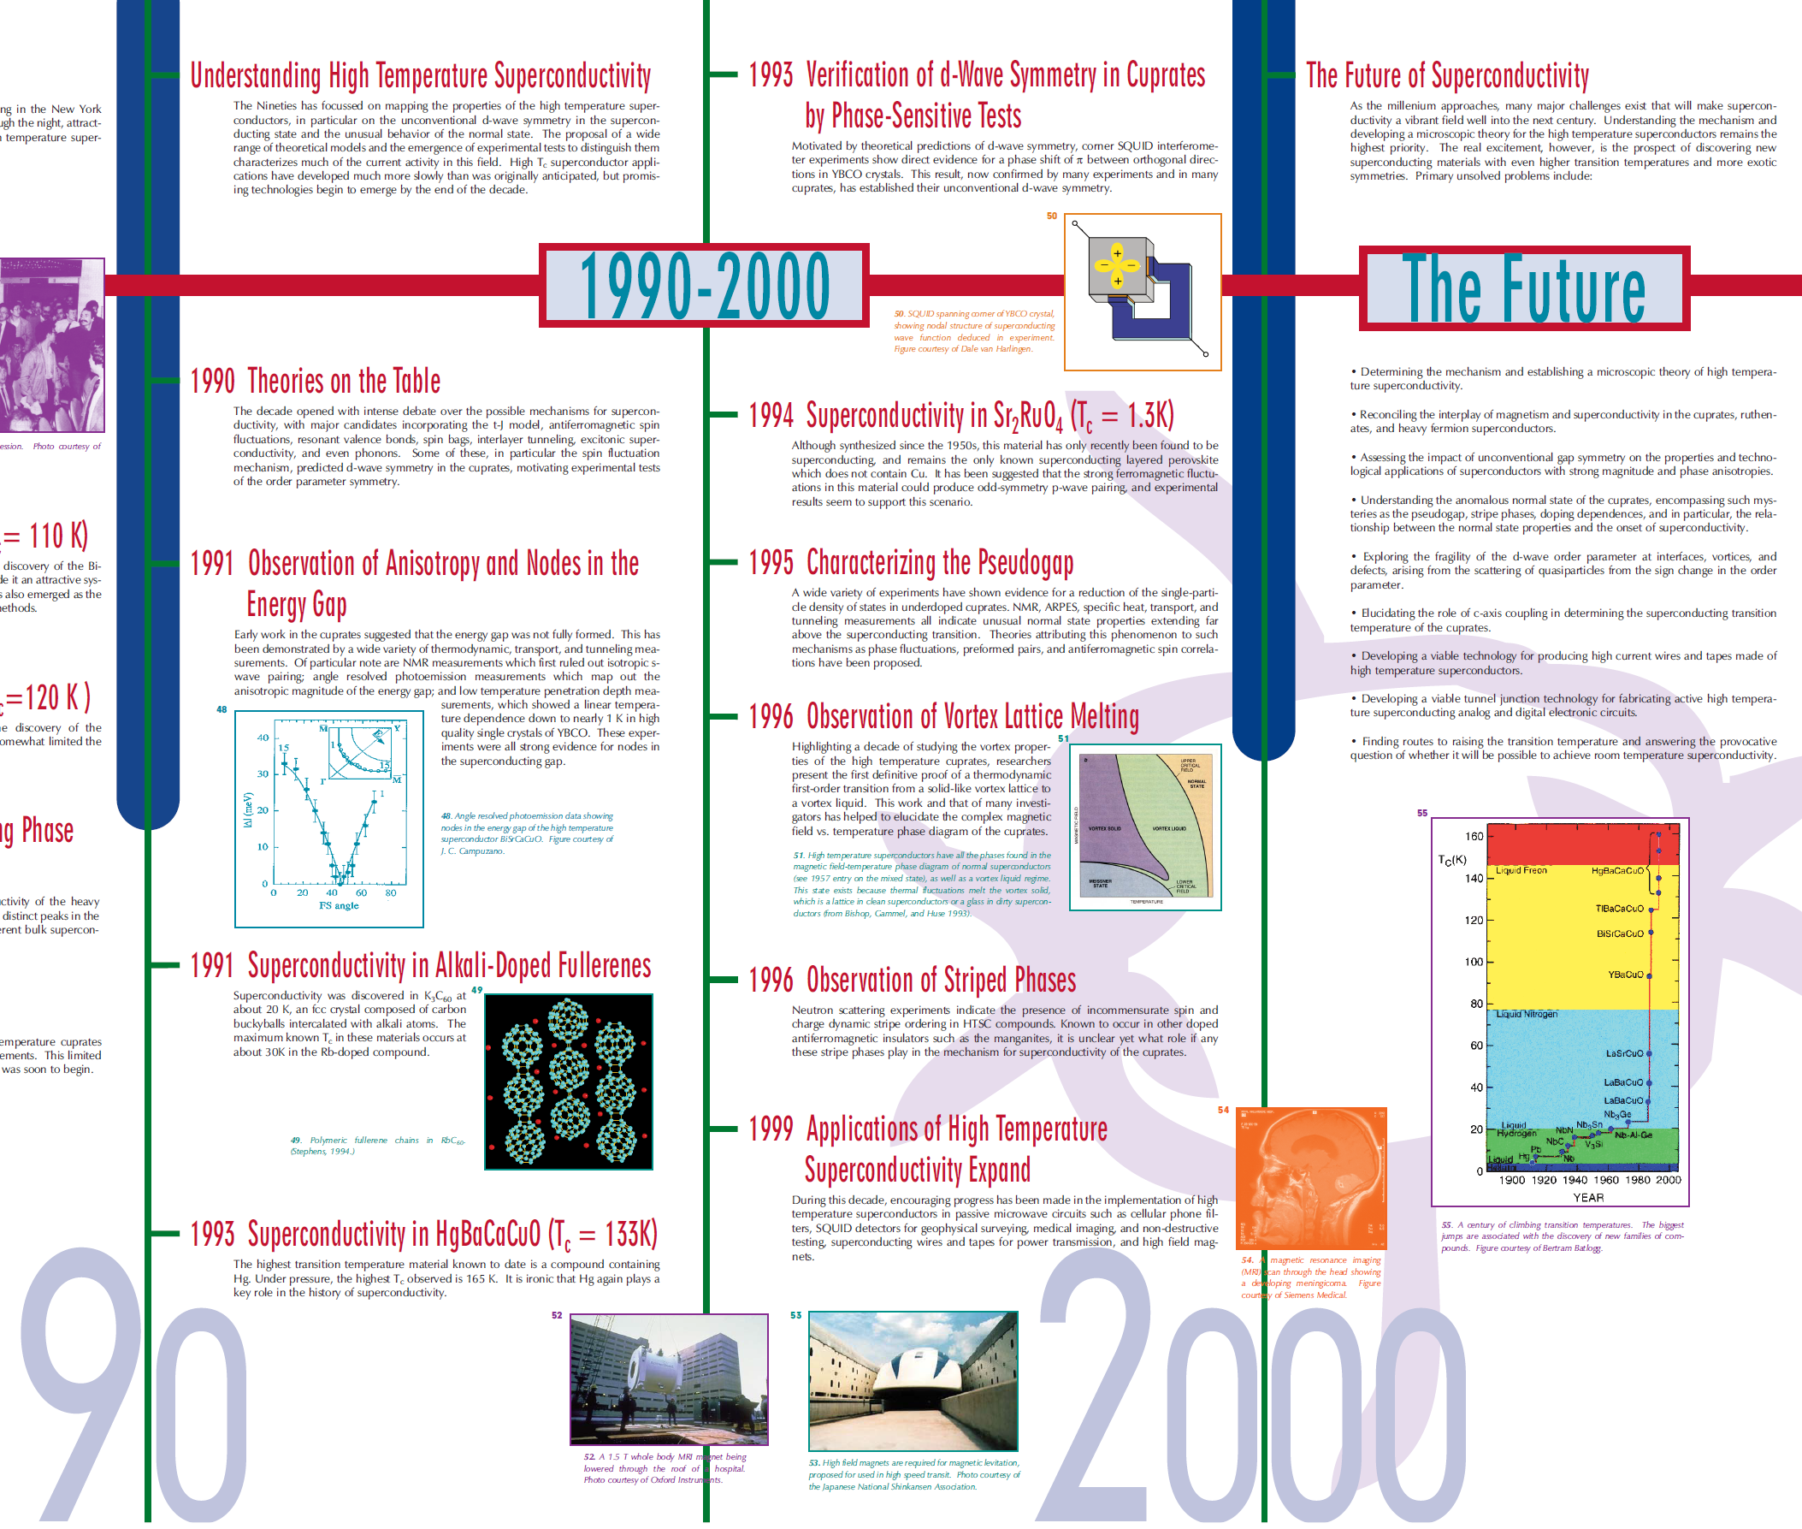
The HISTORY of SUPERCONDUCTIVITY and SUPERCONDUCTOR DEVICES (1990-2000)

Slide 22
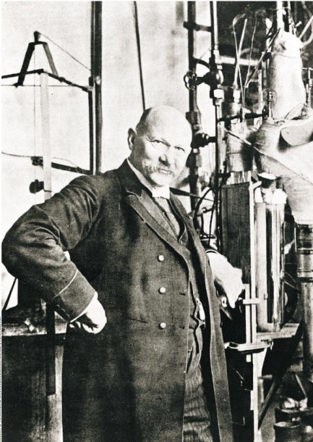
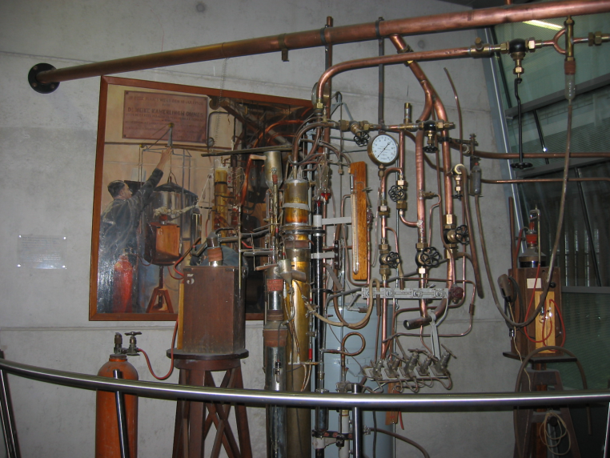
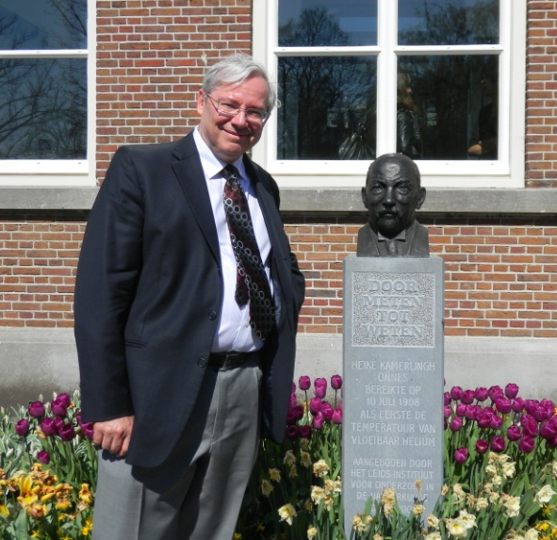
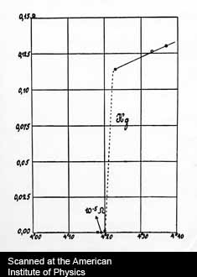
The Discovery of Superconductivity (1911)
First to liquify helium in 1908
Kamerlingh Onnes Lab, Leiden
Heike Kamerlingh Onnes Leiden, Netherlands
Cryogenics – low temperature physics
Get rid of thermal motion
Observe onset of new phenomena
Resistance (Ω)
Superconductivity  R=0
Temperature (K)

Slide 23
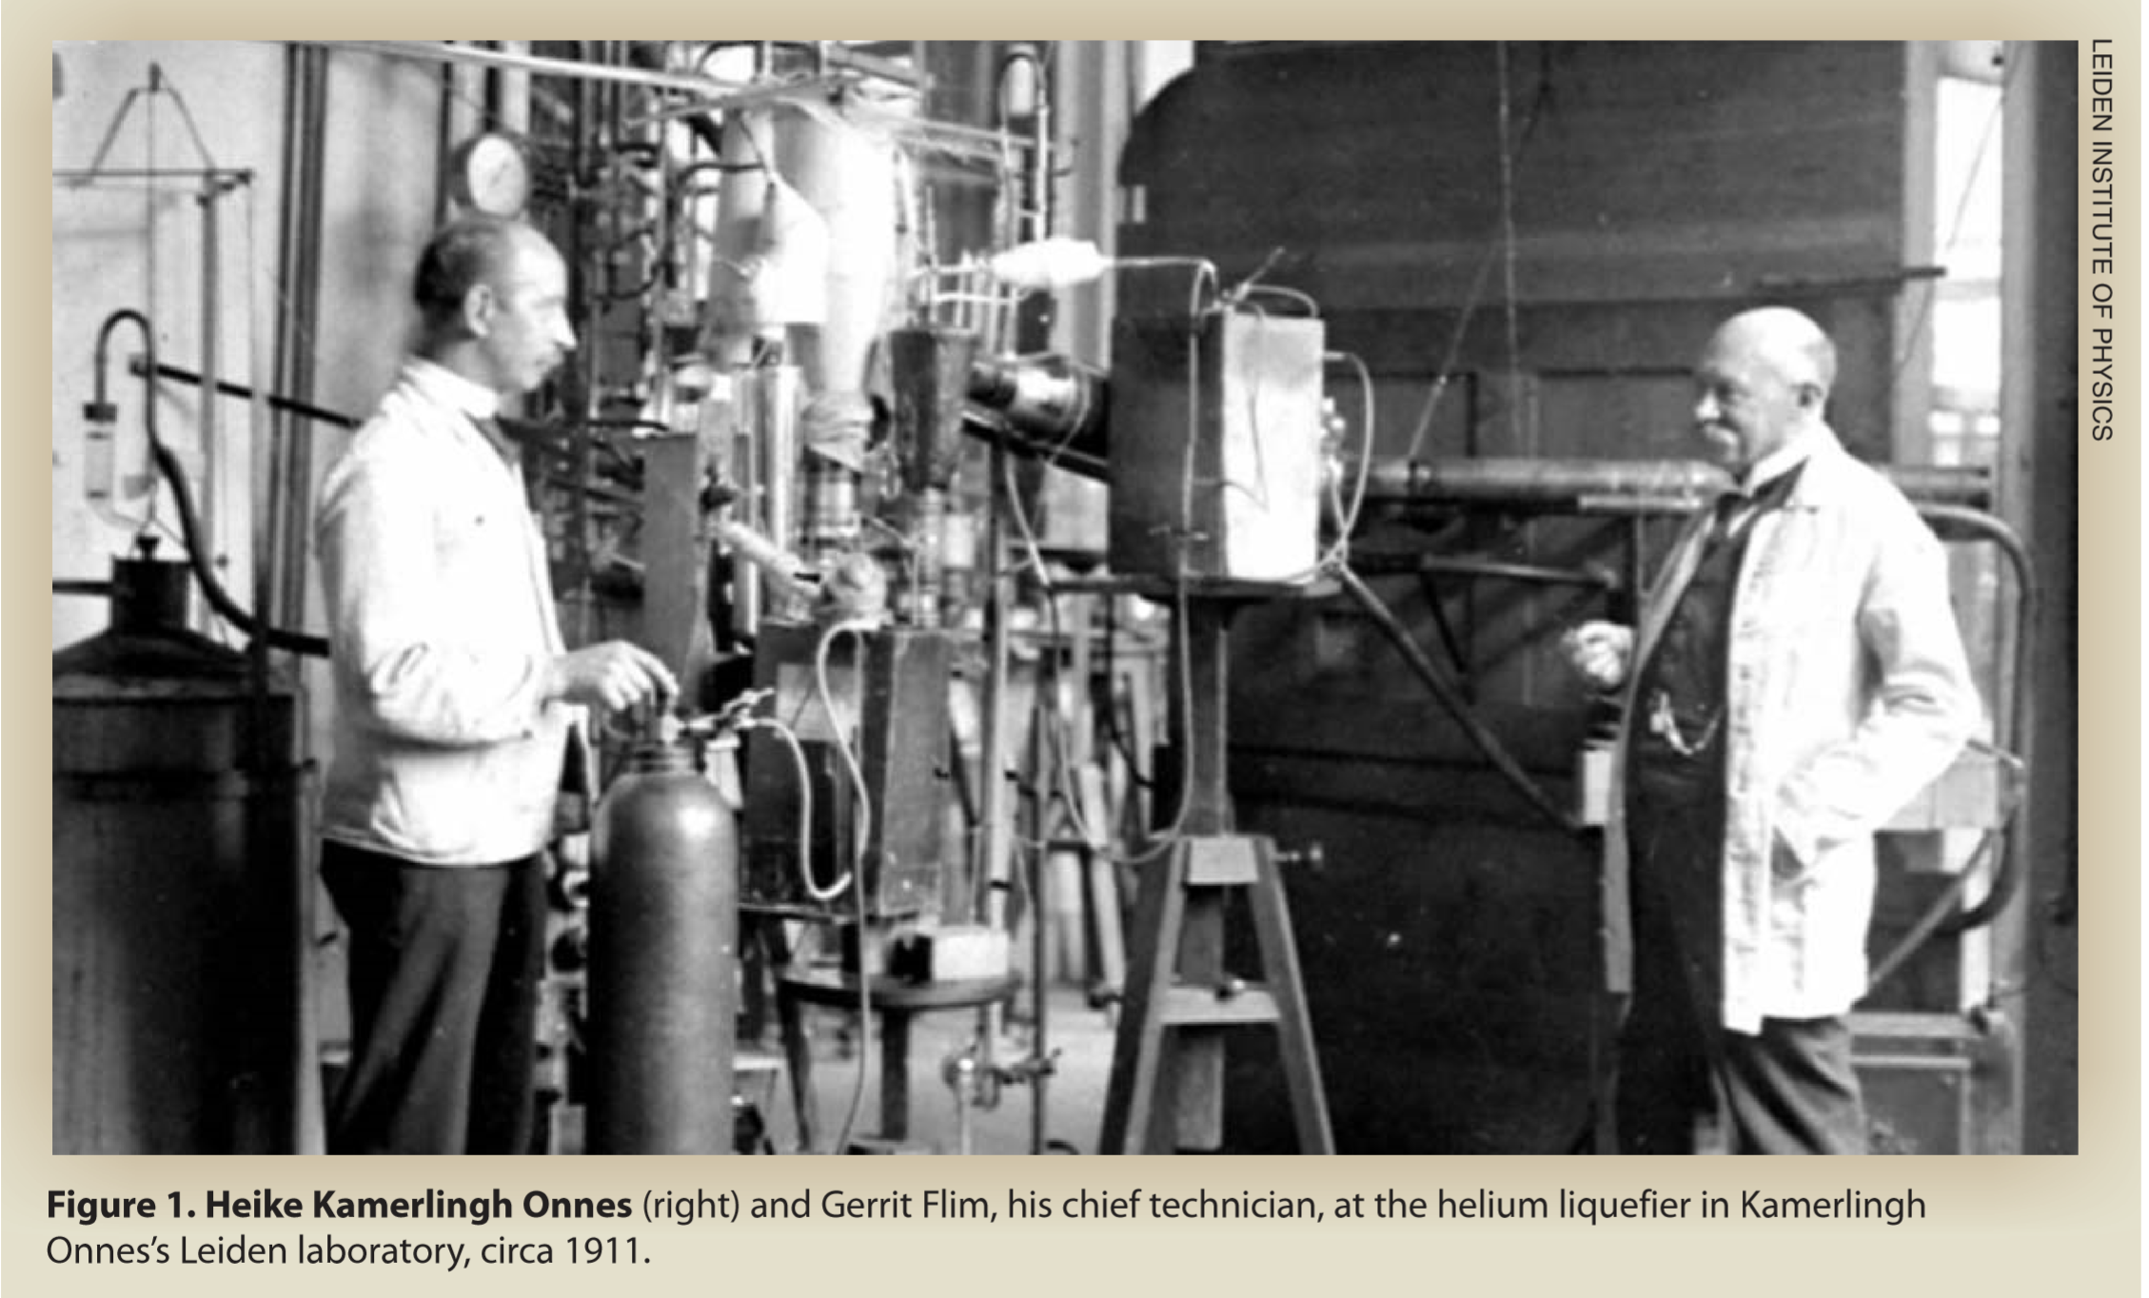
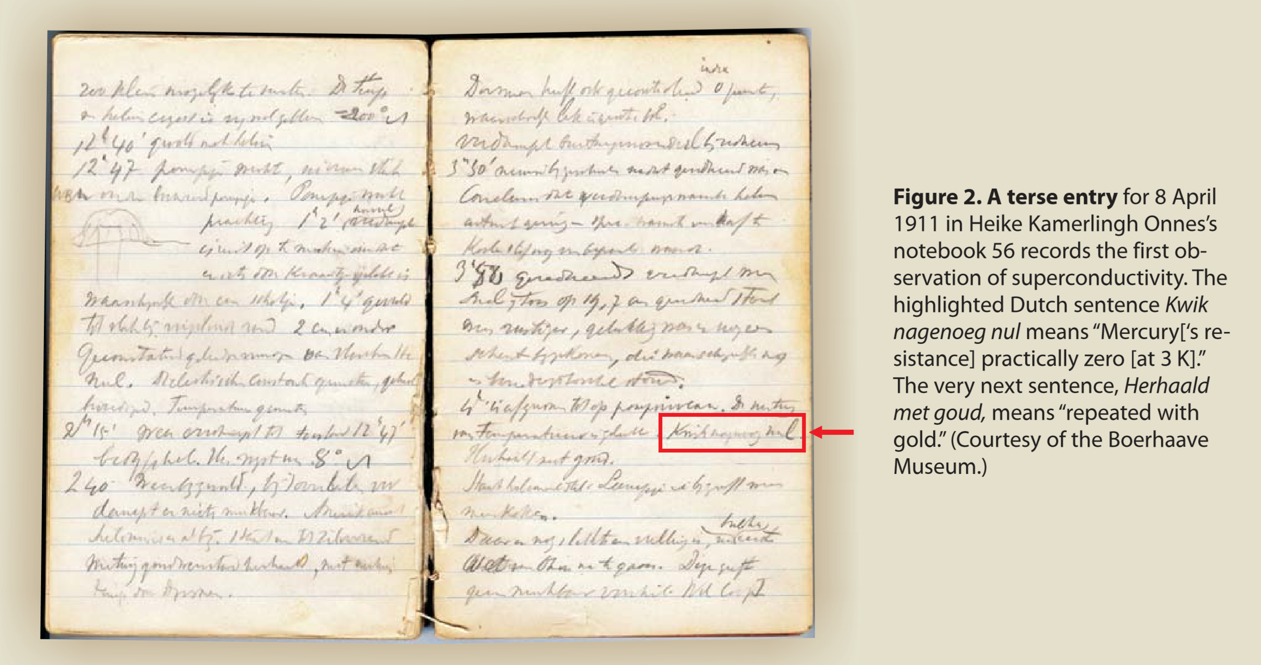

Slide 24
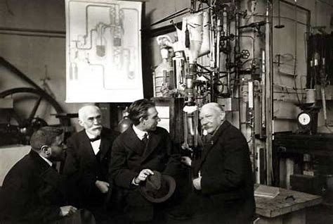
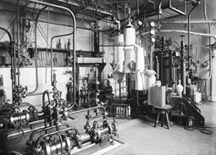
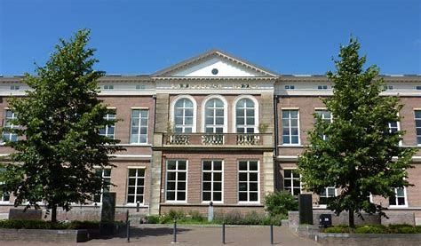
B9 MRL ?
Kamerlingh Onnes Laboratory today --- the Law School

Slide 25
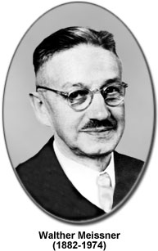
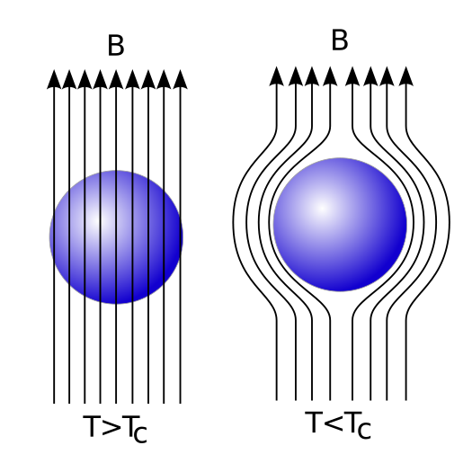
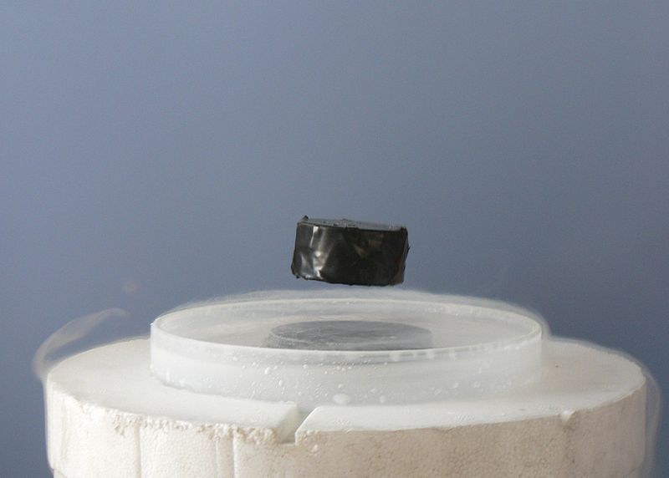
Meissner Effect (1934)
magnetic field expelled from inside a superconductor
“diamagnetism”
Superconductivity is more than just a state with zero resistance
B = 0

Slide 26
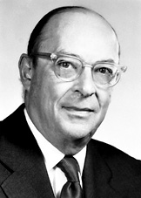
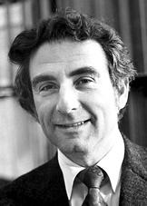
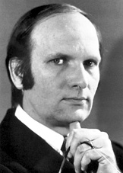
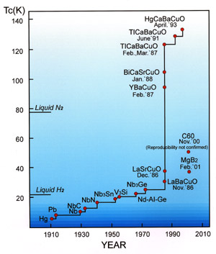
Conventional (“classic”) superconductivity
BCS theory:
Bardeen, Cooper, Schrieffer (1957)
k'
k
1
q
2
MECHANISM = attractive phonon-mediated
electron-electron interaction  Cooper pairing
-
-
e
e
k
k'
John Bardeen
Leon Cooper
Bob Schrieffer
1
2
GROUND STATE = superfluid pair condensate
ψ = n_{s} e ^{iϕ}
macroscopic phase coherence
phase
EXCITATIONS = normal “quasiparticles” with an isotropic energy gap
k_{z}
Δ(k) = Δ
23.2K
Liquid He
k_{y}
k_{x}
T_{c} increased slowly from 4K to 23K over 75 years from 1911 to 1986
“s-wave”
quasiparticle tunneling spectroscopy reveals the fully-formed energy gap

Slide 27
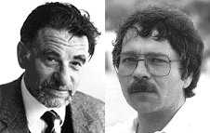
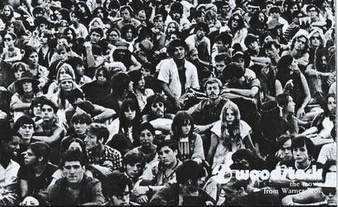
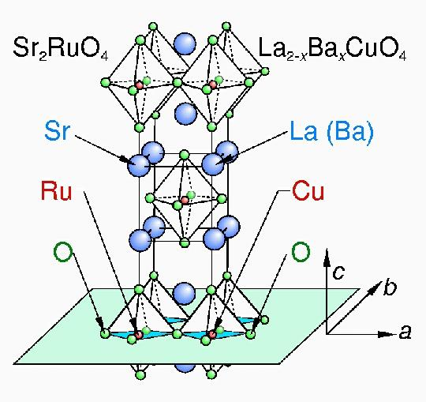
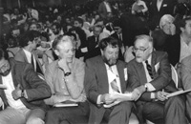


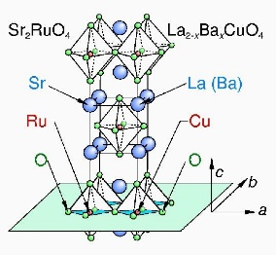
High Temperature Superconductivity (1986)
Woodstock of Music (1969)
Alex Müller
Georg Bednorz
IBM Zurich Research Laboratory
3 days / 33 acts / 500,000 hippies
Woodstock of Physics (1987)
8 hours / 50 talks / 2500 physicists
“Our lives will be changed” … this did not turn out at expected but is rather true for physicists
challenged our understanding of condensed matter physics
opened new opportunities for superconductor research

Slide 28










Progress in SC – Tc vs. time
150
$HBCCO$ (purposes)
125
$$HBCCO$$
$$T_{c}$$
$$TBCCO$$
100
$$LN_{2}$$
$$YBCO$$
# of
papers
75
50
$$LSCO$$
25
$$Nb_{2}Ga$$
$$H_{g}$$
0
$$t$$
1910 1930 1950 1970 1990

Slide 29
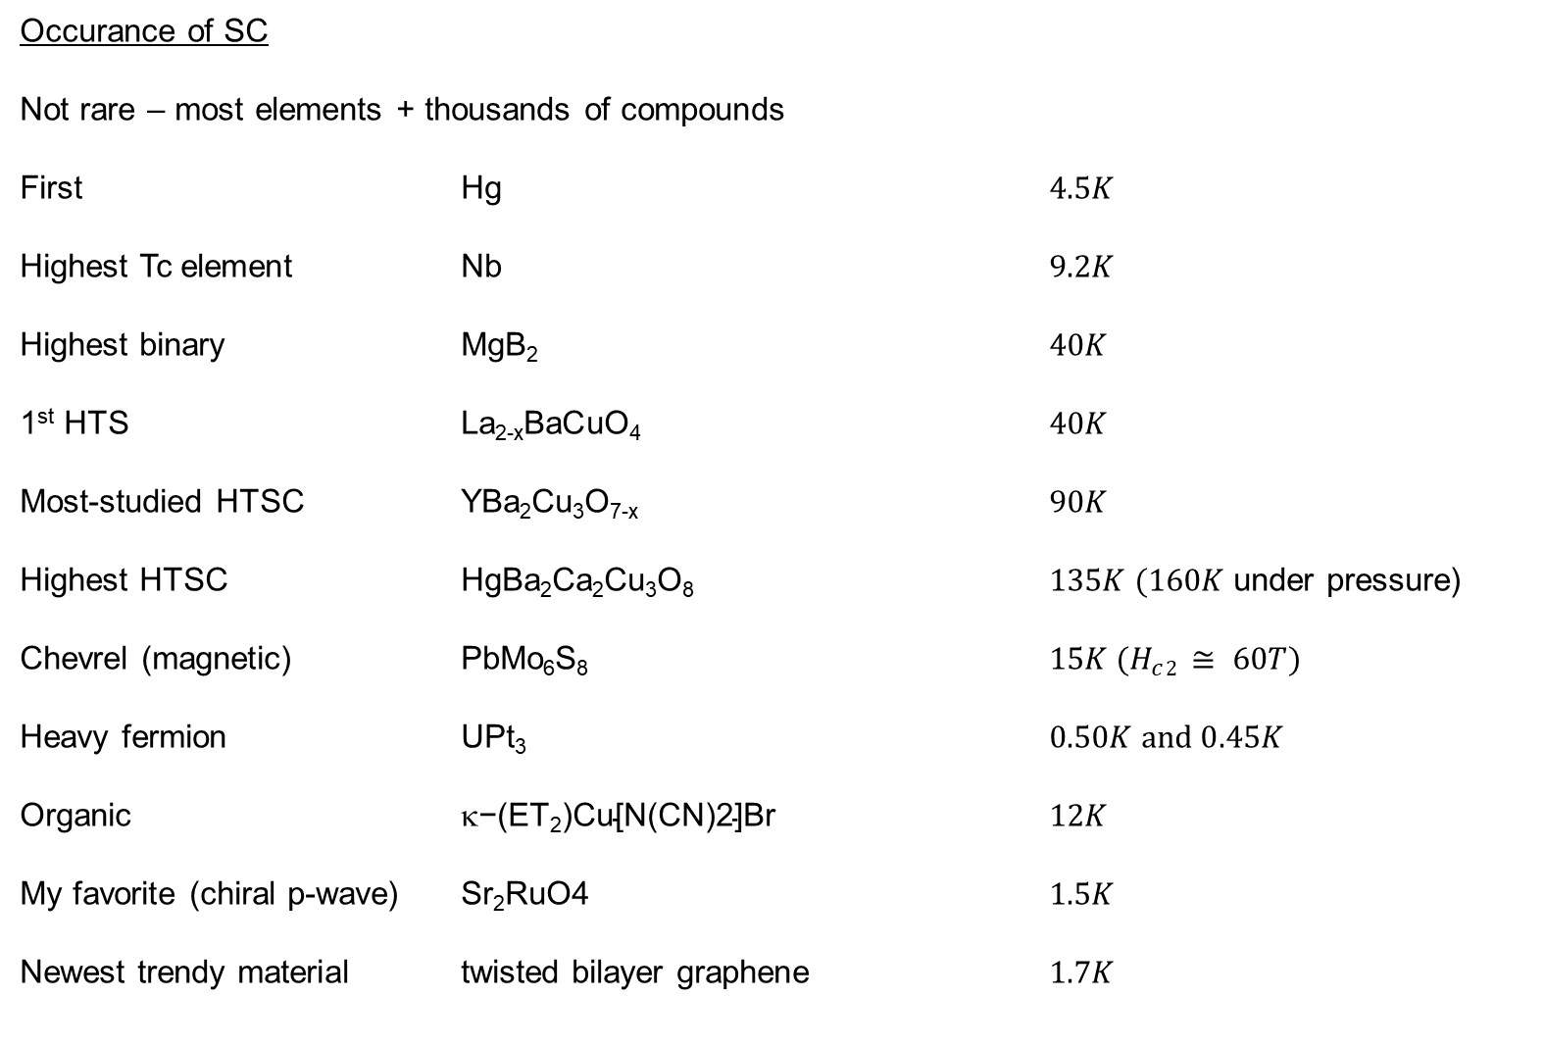
Occurance of SC
Not rare – most elements + thousands of compounds
First Hg $4.5K$
Highest Tc element Nb $9.2K$
Highest binary MgB₂ $40K$
1st HTS La_{2-x}BaCuO₄ $40K$
Most-studied HTSC YBa₂Cu₃O_{7-x} $90K$
Highest HTSC HgBa₂Ca₂Cu₃O₈ $135K (160K$under pressure)
Chevrel (magnetic) PbMo₆S₈ $15K (H_{c}2 ≅ 60T)$
Heavy fermion UPt₃ $0.50K and 0.45K$
Organic $\text{−(}\text{ET}\text{2}\text{)}\text{Cu}\text{[}\text{N}\text{(}\text{CN}\text{)2]}\text{Br}$ $12K$
My favorite (chiral p-wave) Sr₂RuO4 $1.5K$
Newest trendy material twisted bilayer graphene $1.7K$
(two SC transitions)

Slide 30
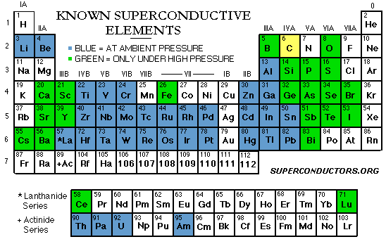
Extent of Superconductivity
+ thousands of metallic compounds and alloys
More illuminating: what materials are NOT superconducting?
Magnetic materials (Mn, Fe, Co, Ni)
Good metals (Cu, Ag, Au)

Slide 31
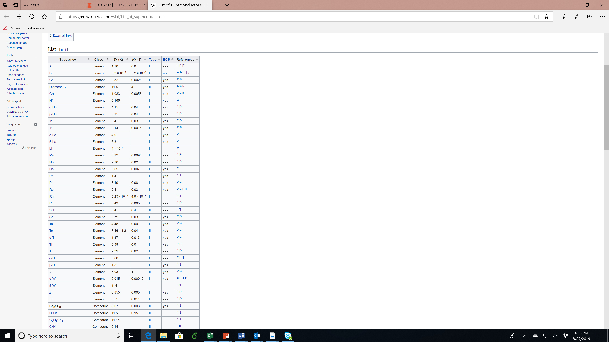
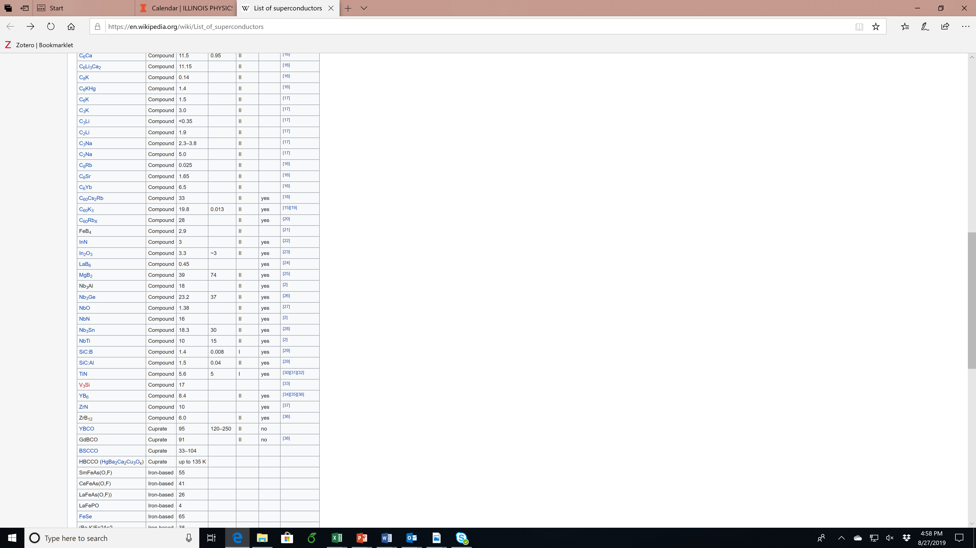
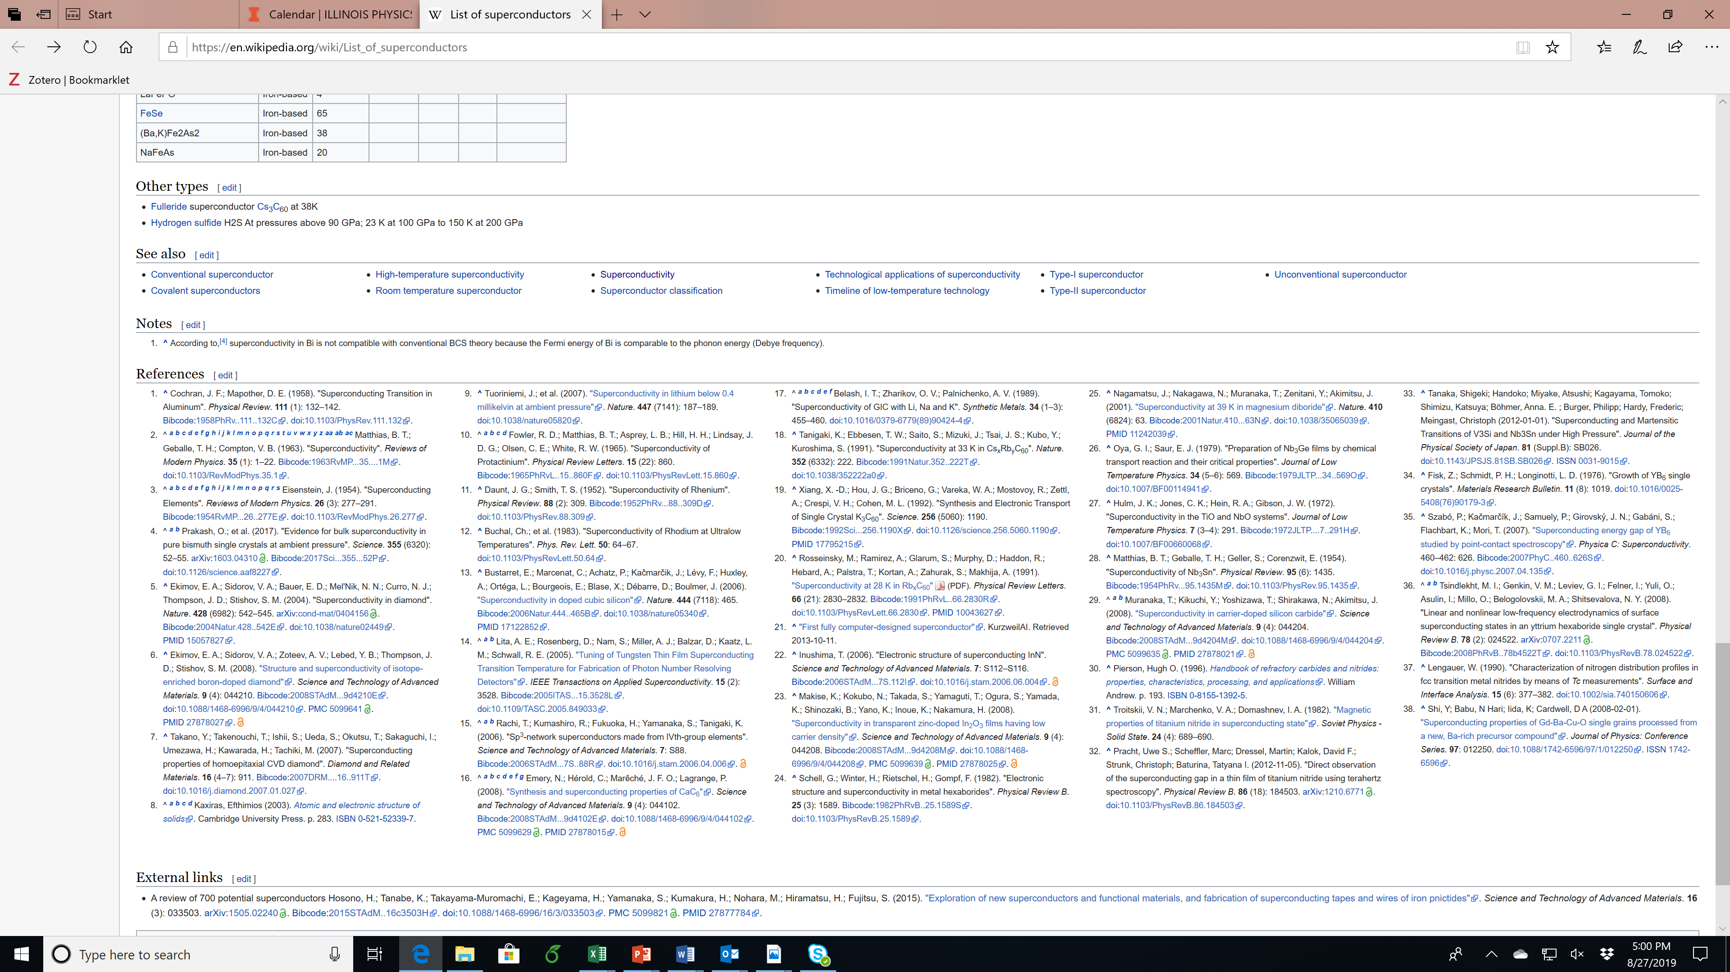
Superconductor Materials and their properties

Slide 32
References for Superconductor Materials and their properties

Slide 33
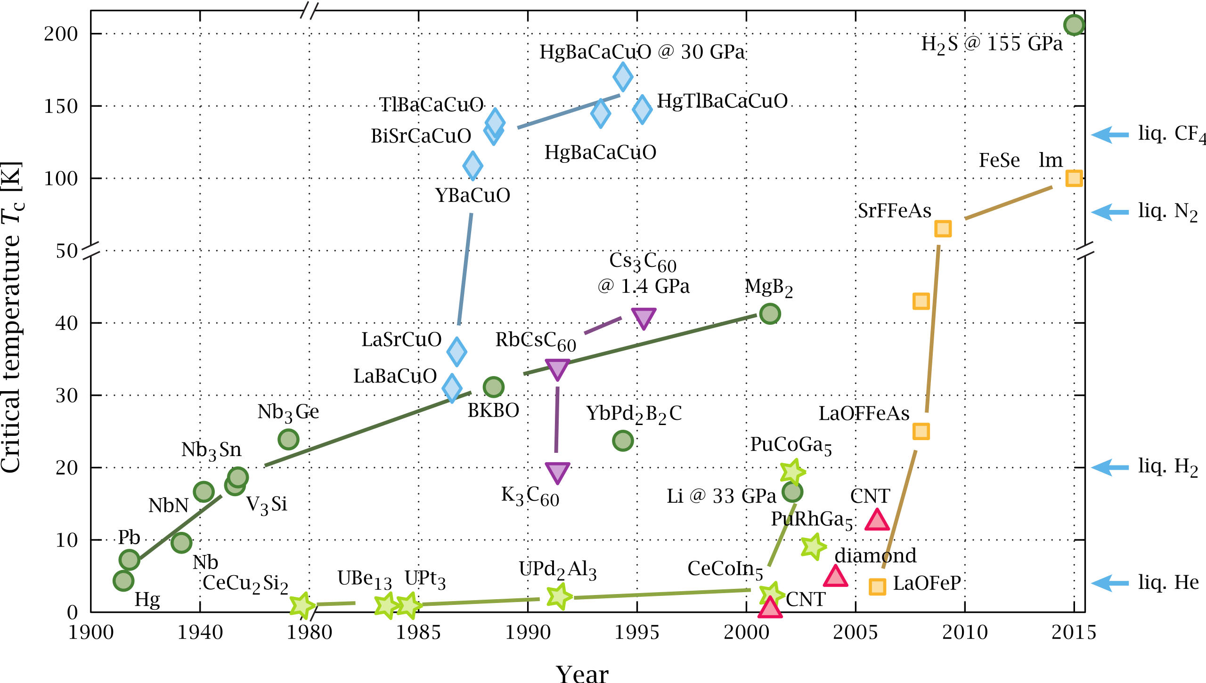
Family tree of superconductors
hydrogen sulphide
fullerenes
conventional
pnictides
carbon

Slide 34
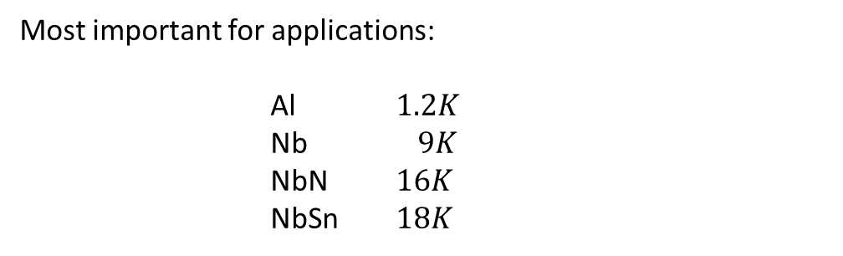
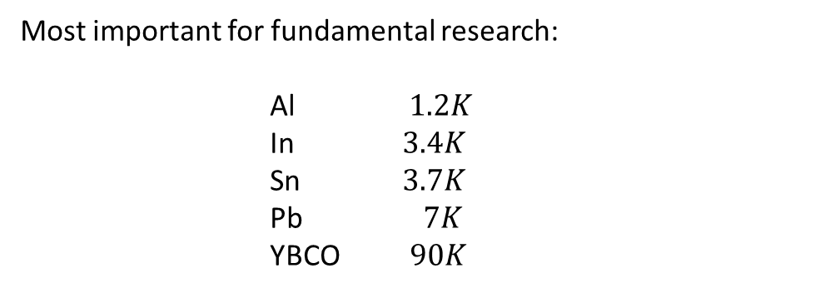
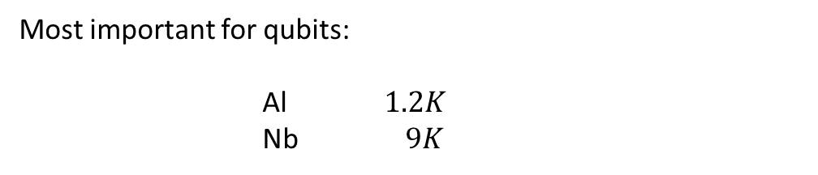
Most important for fundamental research:
Al $1.2K$
In $3.4K$
Sn $3.7K$
Pb $7K$
YBCO $90K$
Most important for applications:
Al $1.2K$
Nb $9K$
NbN $16K$
NbSn $18K$
Most important for qubits:
Al $1.2K$
Nb $9K$

